Slide 1
Operational multi-sensor design for forest carbon monitoring to support REDD+ in Kalimantan, Indonesia
Stephen Hagen (Applied GeoSolutions)
NASA Carbon Monitoring System Project - 2013
Presentation To CMS Science Team November 2014

Slide 2
Project Team
Applied GeoSolutions: Stephen Hagen, William Salas, & Rob Braswell
JPL: Sassan Saatchi
Winrock: Sarah Walker & Sandra Brown
University of New Hampshire: Michael Palace
Collaborators: Orbita Roswintiarti (LAPAN, Indonesia), Deborah Lawrence (University of Virginia), Dirk Hoekman (Wageningen University), Mark Cochrane (South Dakota State University), Laura Grahame (BOS Foundation, Indonesia)

Slide 3
Project Goals
Assist REDD+ stakeholders in Indonesia by contributing data products and improved forest monitoring methods.
The project team is working collaboratively with LAPAN. We will conduct a series of workshops at LAPAN on improved systems for processing two types of forest monitoring data, LiDAR and RADAR, and for tracking uncertainty in the NFMS process.
The project team is working with LAPAN to help validate existing maps, including forest/non-forest (activity data) and biomass maps (emission factor data).
Develop improved National Forest Monitoring System (NFMS) methods (e.g. mapping biomass, activity, and carbon loss from degradation; tracking uncertainty) that are useful across regions.
We aim to provide improved data processing techniques that can be applied in other regions, as well. The project team will publish peer-reviewed papers accessible to others around the world.

Slide 4
Project Objectives
Project region: Kalimantan, Indonesia (all 5 provinces)
Project timeline: September 2013 through September 2016 (3 years)
Project objectives:
Contribute to improved wall-to-wall forest carbon stock maps using LiDAR, radar, and optical data
Improve the mapping of carbon emissions associated with degradation using LiDAR and radar (important for REDD+, but are not currently included)
Develop an uncertainty tracking system for NFMS

Slide 5
Project Details
Purchase commercial airborne LiDAR data from Surtech collected over 30 stratified randomly selected transects and 15 sites associated with field observations across Kalimantan (~65,000 ha).
Use existing ground measurements of biomass and carbon loss from degradation from an array of resources (BOS, CIFOR, Tropical Forest Foundation, NFI?,etc.).
Relate LiDAR to forest carbon in multiple types of forests, including logged and degraded areas in the locations where we have both ground observations and LiDAR data.
Calibrate radar and optical data to the field and LiDAR observations to a) map forest carbon stocks across Kalimantan and b) estimate carbon loss associated with logging and degradation across Kalimantan.
Create software tools to track uncertainty from the field sampling and measurements through final wall-to-wall maps.
Hold a series of capacity building workshops at LAPAN on the use of LiDAR and RADAR for forest monitoring.
Assist in the validation of the INCAS maps. Essentially, we will help refine & improve technical components of an NFMS for Kalimantan.

Slide 6
LiDAR Data Details
LiDAR data is collected via airplane.
Collection conducted by Surtech, an Indonesian company based in Jakarta
Collection has commenced and will last for up to four weeks.
Collection includes LiDAR data over ~65,000 ha of forest across Kalimantan.
Sampling density of between 4 and 10 pulses per square meter.
Data will be processed by Surtech (Indonesia), LAPAN (Indonesia), Applied GeoSolutions (USA), and the University of New Hampshire (USA). This team will also lead a workshop at LAPAN on the processing and use of LiDAR data.

Slide 7
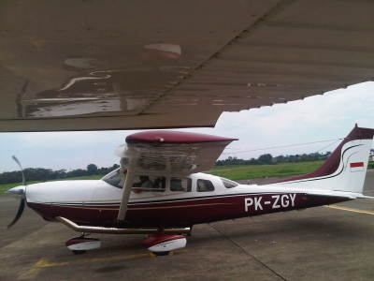
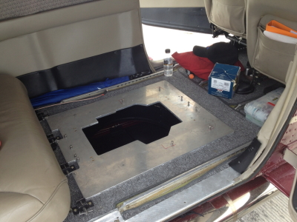
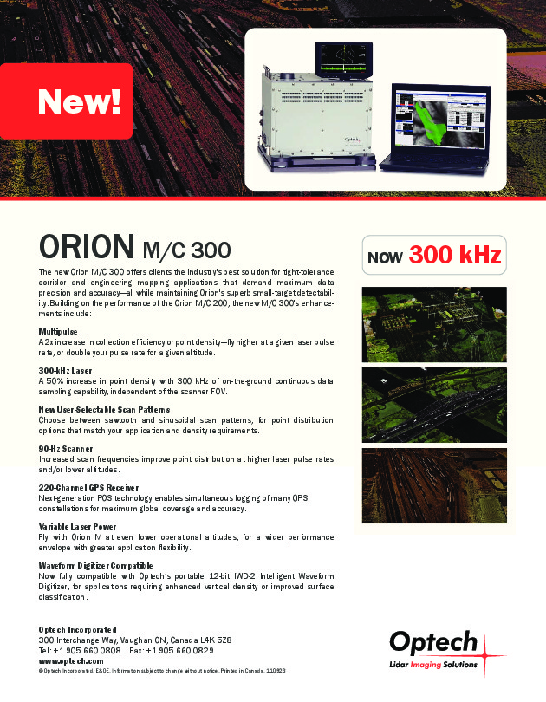
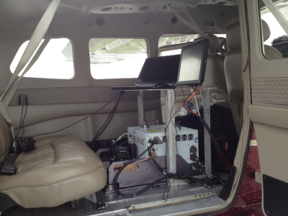
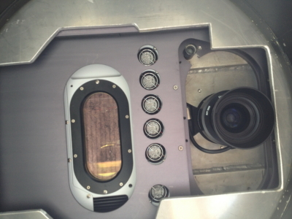
More LiDAR Data Details
The plane and LiDAR instrument are owned and operated by the Indonesian company, Surtech, and all security clearances have been obtained.

Slide 8
Processing LiDAR data
LiDAR data provide a 3-dimensional picture of the terrestrial surface. The data are delivered as a “point cloud”. Extensive processing is required to convert these data to useful information.
The data processing includes:
very accurately matching of the data points to their true ground location (geo-referenced).
separating points that are returned from the ground surface from points returned from the vegetation (accurate ground point classification).
creating a continuous, contoured map of the ground surface from the individual ground point classification (digital terrain model).
creating a continuous, contoured map of the vegetation surface from the highest return points (digital surface model).
subtracting the ground surface map from the vegetation surface map to estimate vegetation height.
identifying features in the point cloud associated with logging

Slide 9
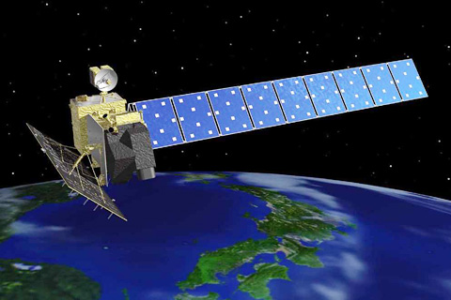
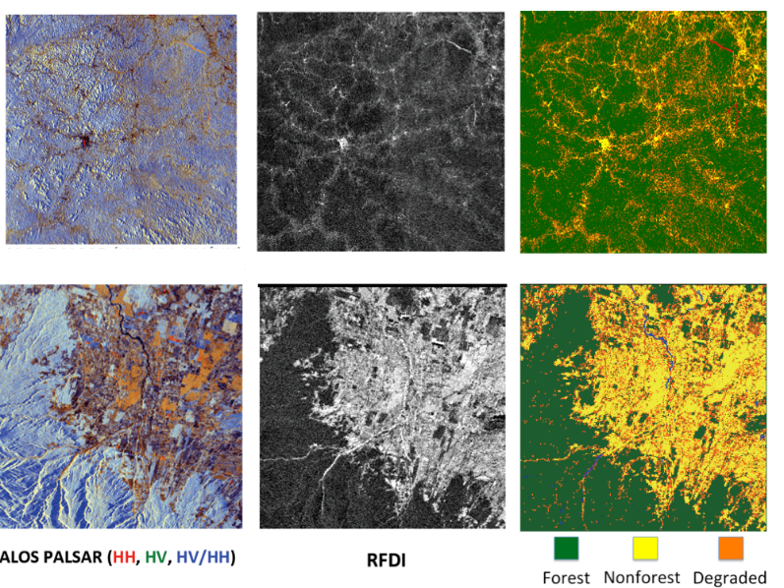
RADAR Data
Space-borne Japanese instrument
ALOS-PALSAR 1 and 2 from JAXA (the Japanese space agency).
L-band synthetic aperture radar
PALSAR 1 acquired data between 2006-2011
PALSAR 2 was launched in May of 2014
Improved methodology for processing SAR data.
Two-step process of slope correction.
Dirk Hoekman of Wageningen University (collaborator) and Sassan Saatchi contribute to the processing of these data and lead workshop on the use of radar data in Indonesia .

Slide 10
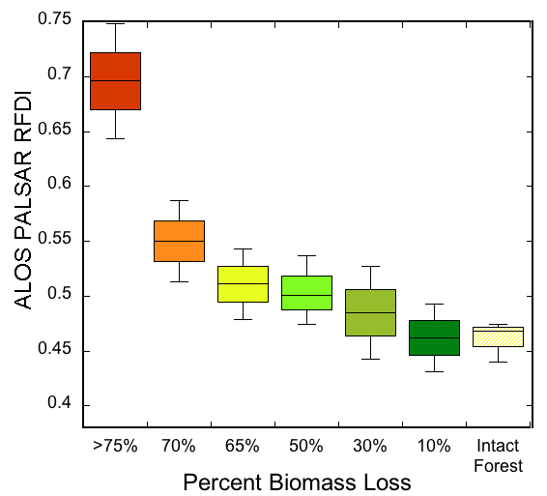
RADAR and Optical Data
Processing over 600 Landsat scenes from Kalimantan for tracking logging impacts.
PALSAR RFDI calculated for 2007-2011 and 2015-2016
Integrating field observations of logging impacts with observations of changes in greenness, npv, and soil signal from Landsat and RFDI from PALSAR to map logging impacts across Kalimantan.

Slide 11
Project Outcomes
The international REDD+ MRV community will gain accesses to information about a real-world application of LiDAR and RADAR data to forest monitoring.
NASA will gain information on the use of LiDAR and RADAR technology which can be useful for future satellite missions (LiDAR, RADAR).
LAPAN will gain experience:
processing and applying of LiDAR data, a valuable tool for forest monitoring;
processing and applying new RADAR methods.
tracking uncertainty in carbon monitoring.
LAPAN will gain validation information for current biomass and forest change products.
This improved capacity at LAPAN will assist Indonesia in meeting its international commitment to reduce GHG emissions by at least 26% and its capacity to access international finance and other benefits.

Slide 12
Questions?
Stephen Hagen, Applied GeoSolutions, shagen@appliedgeosolutions.com

